Slide 1
Noise Removal in Image Processing
2010030408 - K.Pavan Kalyan Srinivasa Varma
2010030205 - K.Sriya Kolanupaka
201030282- Raila Tafheem
2010030191- Naga Venkata Sai Jayanth Gurrala
Under the Guidance of
Professor Panduraju
Computer Science and Engineering Department
KL Hyderabad Off Campus, Aziz Nagar ,Hyderabad

Slide 2
ABSTRACT
Image denoising is the technique of removing noise or distortions from an image.
Noise is a random variation of brightness or color information in images and an undesirable by-product of image that obscures the desired information.
We are removing speckle noise using wiener filter and Gaussian noise using Gaussian filter.

Slide 3
AIM OF PROJECT
The main aim of the project is to remove noise from a noisy image, so as to restore the true image. The image enhancement technique is to improve the interpretability or perception of information in images for human viewers, or to provide better input for other automated image processing techniques.

Slide 4
LITERATURE SURVEY
Median Filter tends to remove image details while reducing noise such as thin lines and corners.
Median filtering performance is not satisfactory in case of signal dependent noise. To remove these difficulties different type of filters have been used for the better results.

Slide 5
SOFTWARE USED
Operating System: Windows
Software: MATLAB Software
Filters used like:
Gaussian Filter
Weiner Filter

Slide 6
PROPOSED SOLUTION
Speckle Noise : Removed using 2D wiener Filter
Gaussian Noise : Removed using Gaussian Filter

Slide 7
WORKING MODEL

Slide 8
clc
clear all
close all
% upload image
cd images
[J P]=uigetfile('*.*','Select Input Image');
I=imread(strcat(P,J));
cd ..
subplot(231),imshow(I),title('Input Image')
% add speckle noise
Ispkl=imnoise(I,'speckle');title('Speckle Noise')
% --- Executes on button press in pushbutton3.
subplot(232),imshow(Ispkl),title('Speckle Noise')
% wiener filter
K = wiener2(Ispkl,[5 5]);
K=imsharpen(K);
subplot(233),imshow(K),title('Wiener Filter')

Slide 9
% gaussian noise
Igauss=imnoise(I,'gaussian');
% --- Executes on button press in pushbutton3.
subplot(234),imshow(Igauss),title('Gaussian Noise')
%gaussian filter
Igaussfilt = imgaussfilt(Igauss,2);
Igaussfilt=imsharpen(Igaussfilt);
subplot(235),imshow(Igaussfilt),title('Gaussian Filter')
suptitle('Noise Removal in Image Processing')

Slide 10
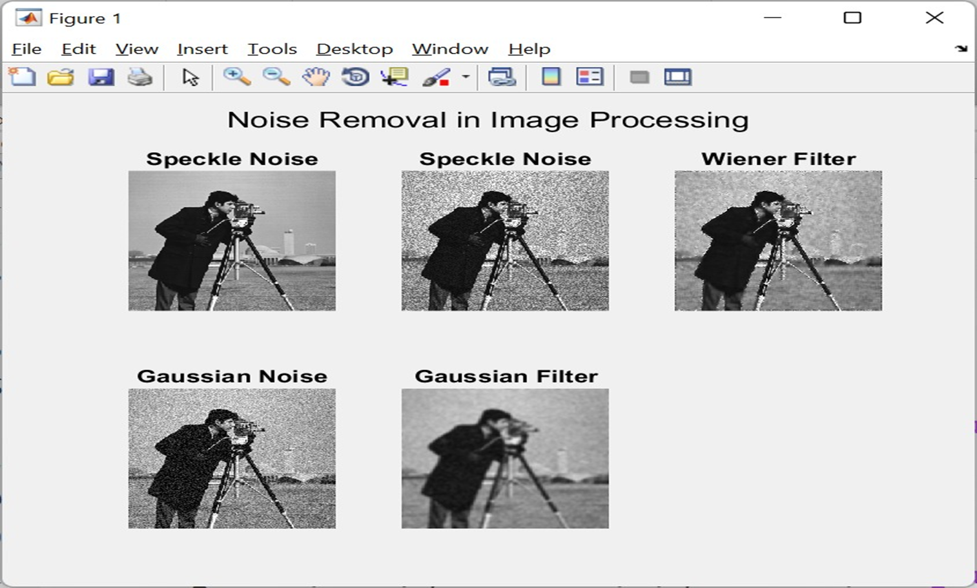

Slide 11
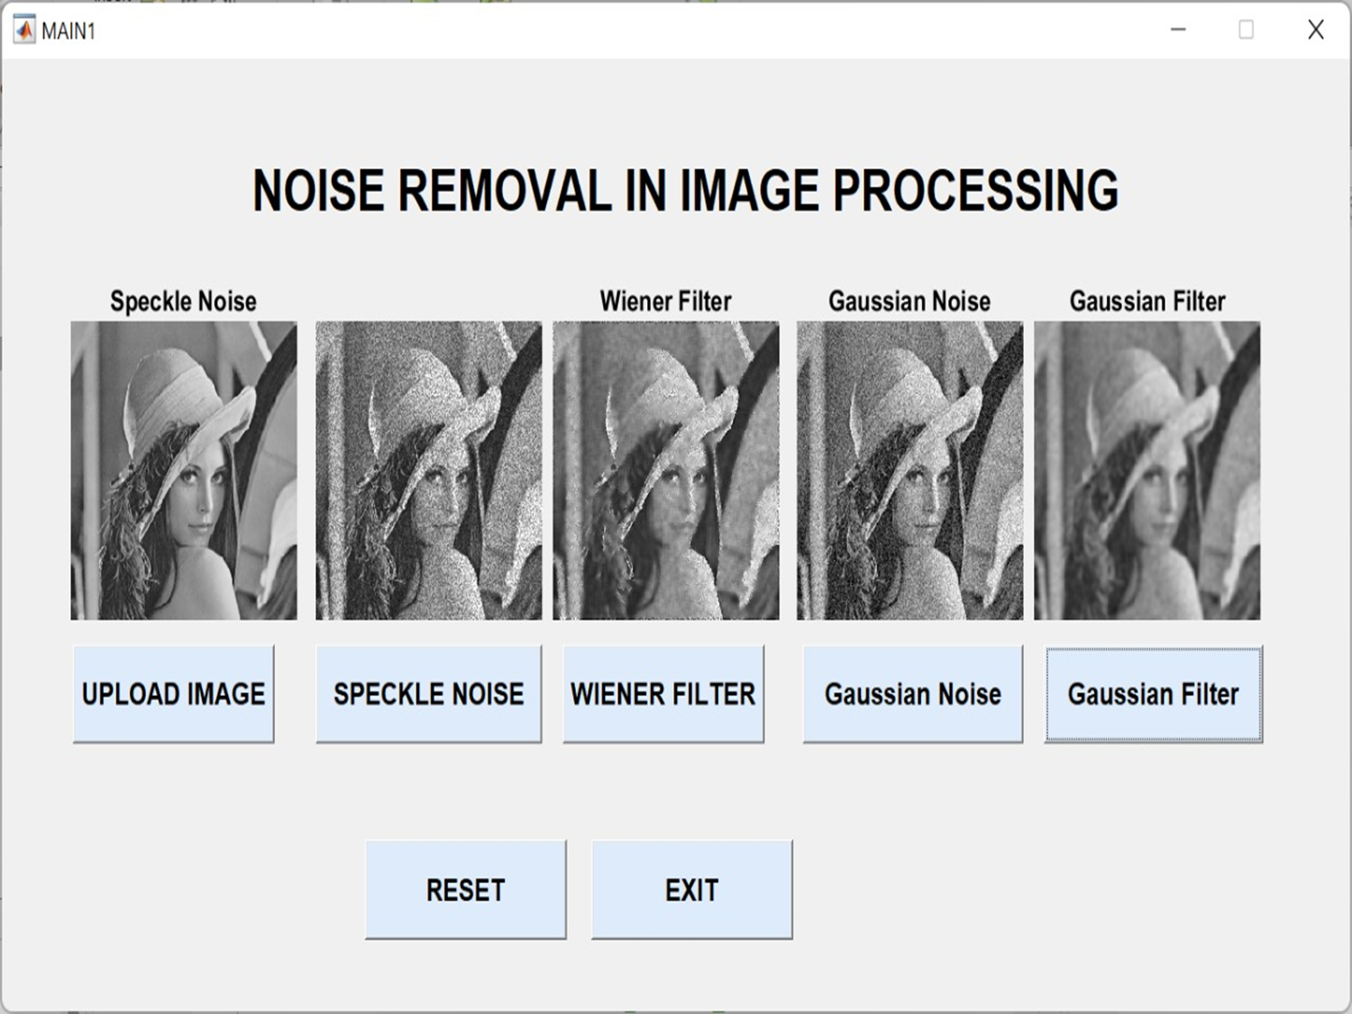
Result

Slide 12
CONCLUSION
CONCLUSION
Filters are used for removing noise from the images.
In this project we successfully implemented wiener filter for speckle noise removal and gaussian filter for gaussian noise removal using MATLAB.
We prepared GUI for showing results of proposed method.
Using any random image we showed that noise is removed from noisy image.
The decision to apply a which particular filter is based on the different noisy level at the different test pixel location or performance of the filter scheme on a filtering mask.

Slide 13
APPLICATIONS
APPLICATIONS
Reducing noise
Reducing blurring region of an image
Removes the additive noise
Remove the noise in ultra sound images and MRI brain images

Slide 14
THANKYOU
THANKYOU

